Slide 1
Cyber
Security

Slide 2
Introduction
01
IN DEPTH
02
Cyber Threats
Datas
TABLE OF CONTENTS
04
03
Types
05
Prevention
06
What Is Cyber Security?
Types Of Cyber Security.
What Is Cyber Threat?
Cyber Attack Datas
Types Of Cyber Threat
How To Prevent Cyber Threat.

Slide 3
01
Cyber Security
What Is Cyber Security?

Slide 4
Cyber Security
Cybersecurity is the protection of internet-connected systems such as hardware, software and data from cyber threats.
The practice is used by individuals and enterprises to protect against unauthorized access to data centers and other computerized systems.

Slide 5
These Cyber Attack are usually aimed at accessing, changing, or destroying sensitive information; extorting money from users; or interrupting normal business processes.
Implementing effective cybersecurity measures is particularly challenging today because there are more devices than people, and attackers are becoming more innovative.

Slide 6
02
Types
Types Of Cyber Security

Slide 7
Types Of Cyber Security
Cyber
Security
Application Security
Network
Security
Cloud
Security
Internet of Things
Critical Infrastructure
security

Slide 8
Application Security
Application security is the process of developing, adding, and testing security features within applications to prevent security vulnerabilities against threats such as unauthorized access and modification.

Slide 9
Network Security
Network security is a set of technologies that protects the usability and integrity of a company’s infrastructure by preventing the entry or proliferation within a network of a wide variety of potential threats.
.

Slide 10
Cloud Security
Cloud security, also known as cloud computing security, is a collection of security measures designed to protect cloud-based infrastructure, applications, and data. These measures ensure user and device authentication, data and resource access control, and data privacy protection.

Slide 11
Internet of Things
Internet of Things Security is the act of securing Internet devices and the networks they're connected to from threats and breaches by protecting, identifying, and monitoring risks all while helping fix vulnerabilities from a range of devices that can pose security risks to your business.

Slide 12
Critical infrastructure security
Critical infrastructure security is the area of concern surrounding the protection of systems, networks and assets whose continuous operation is deemed necessary to ensure the security of a given nation, its economy, and the public's health and/or safety.

Slide 13
03
Datas
Cyber Attack Datas

Slide 14
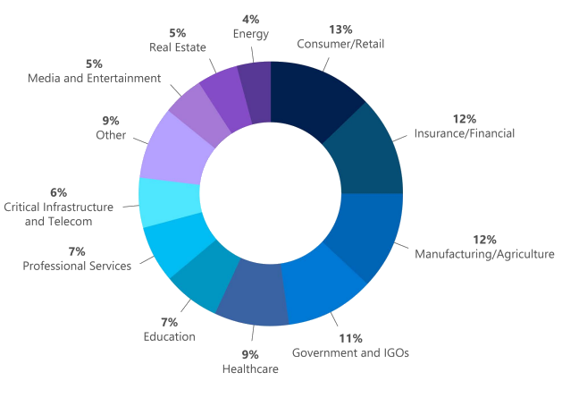
Sectors most targeted by Cyber Attack

Slide 15
04
Cyber Threat
What Is Cyber Threat?

Slide 16
What Is Cyber Threat
A cyberattack is any offensive maneuver that targets computer information systems, computer networks, infrastructures, or personal computer devices.
An attacker is a person or process that attempts to access data, functions, or other restricted areas of the system without authorization, potentially with malicious intent.
Depending on the context, cyberattacks can be part of cyber warfare or cyberterrorism.. A product that facilitates a cyberattack is sometimes called a cyber weapon.

Slide 17
05
Types Of Cyber Threat
The Three Major Types Of Cyber Threat

Slide 18
Types Of Cyber Threat
Cyber
Threat
Computer
Virus
Hackers
Phishing
Or
Spam

Slide 19
Computer Virus
Perhaps the most well-known computer security threat, a computer virus is a program written to alter the way a computer operates, without the permission or knowledge of the user.
A virus replicates and executes itself, usually doing damage to your computer in the process.

Slide 20
Hackers
They are people, not computers, create computer security threats and malware.
Hackers and predators are programmers who victimize others for their own gain by breaking into computer systems to steal, change, or destroy information as a form of cyber-terrorism.
These online predators can compromise credit card information, lock you out of your data, and steal your identity.

Slide 21
Phishing
Phishers attempt to steal sensitive financial or personal information through fraudulent email or instant messages.
Phishing attacks are some of the most successful methods for cybercriminals looking to pull off a data breach.

Slide 22
06
Prevention
How To Prevent Cyber Threat?

Slide 23
10 Ways to Prevent Cyber Attacks
Train your staff
Keep your software and systems fully up to date
Ensure Endpoint Protection
Install a Firewall
Backup your data
Control access to your systems
Wifi Security
Access Management
Passwords

Slide 24
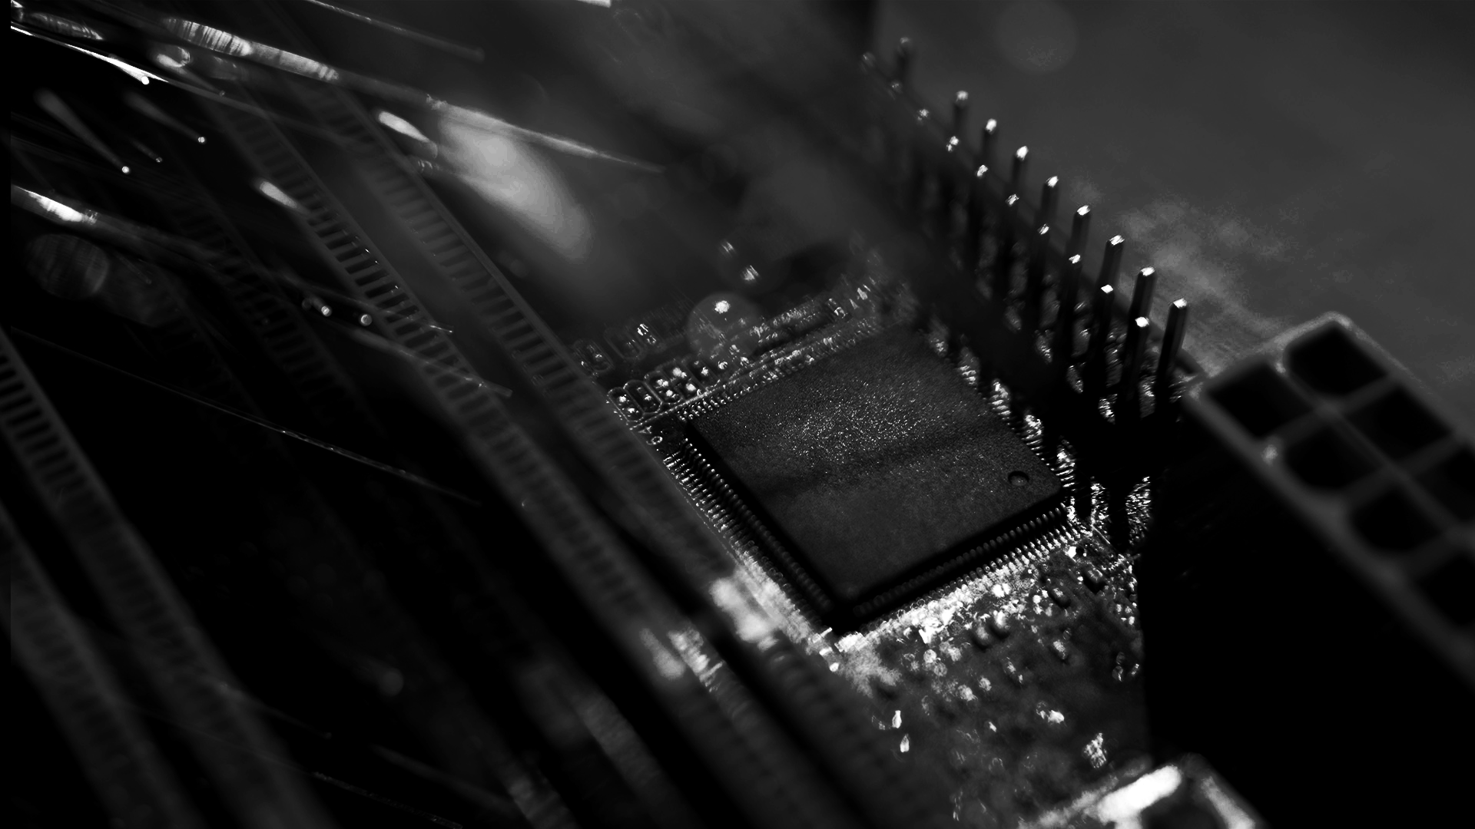
AWESOME WORDS

Slide 25
“Technology trust is a good thing,
but control is a better one.” Stephane Nappo

Slide 26
Thank You

